Slide 1
2016 Platform EGU Workgroup Kickoff Call: Base Year and Modeling Issues
January 25, 2018
Alison Eyth
EPA Office of Air Quality Planning and Standards

Slide 2
Contents
Overview of 2016 Platform Process
Development of 2016 Point Emissions
Matching Base Year and Future Year Emissions
Temporalizing EGU Emissions

Slide 3
2016 Collaborative Process
Regional modeling organizations and states asked to be more involved in the development of the next modeling platform
States need a new platform to develop State Implementation Plans for the 2015 National Ambient Air Quality Standards for Ozone, and also for Regional Haze
States often have better access to local information
States and regions would like to have more input into the methods used, particularly those used to develop “projections” of emissions to future years
For the first time, EPA is supporting a collaborative process to develop a new emissions modeling platform for 2016

Slide 4
Organizational Structure of the 2016 Effort
Overall co-leads: Zac Adelman of the Lake Michigan Air Directors Consortium (LADCO) and Alison Eyth of EPA
Coordinate communication, develop processes to be followed, help resolve issues, specify documentation requirements, facilitate distribution of data to stakeholders
Coordination committee: regional, state, EPA leaders that help define the process, run workgroups, and resolve issues that come up
Sector-specific Workgroups: co-led by one regional/state and one EPA staff (where possible) with participants from states/locals/regions and EPA
Focus on preparing emissions estimates for 2016 and future years, plus improve modeling of the emissions sectors

Slide 5
2016 Platform Schedule
2014NEIv2 is needed as the starting point
Several versions of 2016 platform will be developed
Alpha: preliminary version with 2016 emissions for some sectors and 2014 for the rest (February, 2018)
Beta: improved version of 2016 emissions for most sectors and preliminary projected emissions to 2023 and 2028 (Summer-Fall, 2018)
Timing of projections is uncertain
V1.0: fully updated 2016 emissions and complete projected emissions for 2023 and 2028 (Winter, 2019)
Wiki for meeting notes/status
http://vibe.cira.colostate.edu/wiki/wiki/9169

Slide 6
2016 Alpha Platform Emissions
The 2014 National Emissions Inventory, version 2 (2014NEIv2) will be the starting point for many sectors (especially nonpoint sectors)
2014NEIv2 point sources (until March, 2018)
2016 Continuous Emissions Monitoring Systems (CEMS) data
Note that the annual inventory is ideally synchronized with 2016 CEMS
Onroad mobile source emissions based on 2014NEIv2 inputs projected to 2016 will be available
Nonroad mobile source emissions based on inputs for 2014NEIv2 will be available
Wild, prescribed, and agricultural fire emissions for 2016
Biogenic emissions for 2016
Other sectors may be adjusted to 2016 (e.g., oil and gas)
Recent emissions modeling improvements to temporal allocation, spatial allocation, and speciation can be incorporated

Slide 7
2016 Point Source Inventory
Point sources for 2016 were submitted by states by January, 2018
Submission of Type A (large) sources was required
Draft 2016 point inventory will be available in March, 2018
Based on submitted 2016 data – including closures
2014/15 data carried forward where not submitted or closed
States (workgroup members) can comment on the inventory through May, 2018
Emissions, stack parameters, matching to ORIS IDs for CEMS matching, matching to sources in IPM NEEDS database
Updates to state-provided data put into EIS by states
Contact EPA with questions about augmented data and with any updated ORIS and NEEDS matches
2016 Point inventory released in July, 2018

Slide 8
Base Year – Future Year Matching
Sources are segregated into EGUs and non-EGUs because different projection techniques are used for each category
EGU models estimate only future year EGU emissions
Non-EGUs are projected using growth and control factors
Important to get EGU/non-EGU categorization right
Facilities can have both EGU and non-EGU units
Stack parameters and locations are usually carried forward from the base year inventory
Also need solid mapping to ORIS and NEEDS IDs

Slide 9
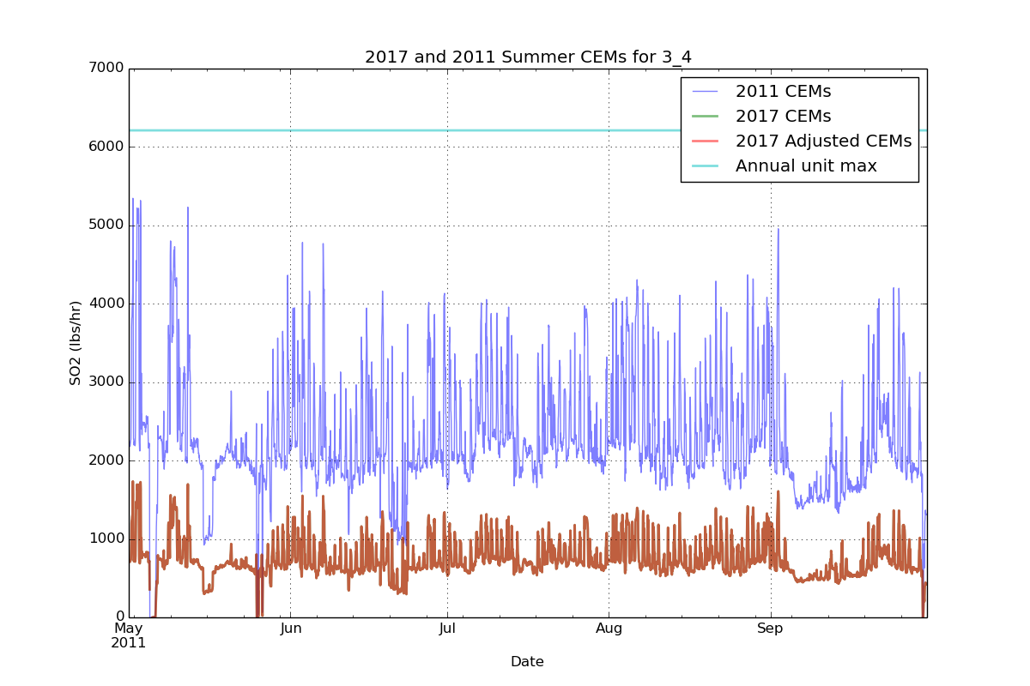
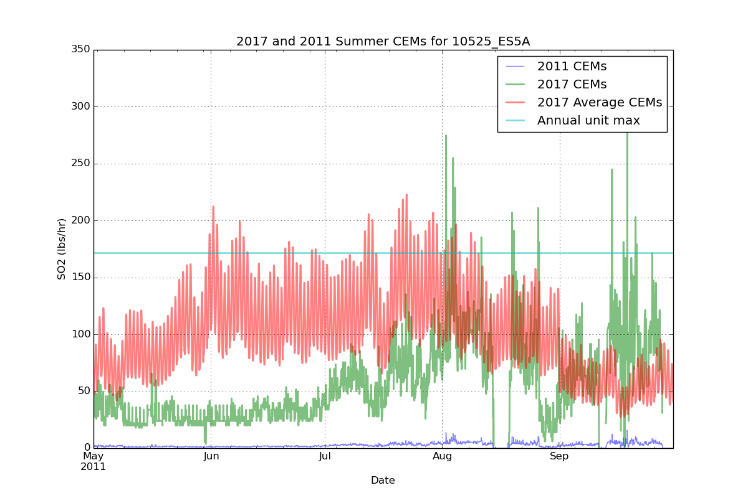
Temporal Allocation for EGUs with CEMS
For sources with CEMS, the CEMS data are used for hourly emissions in the base year
In future years, emissions are scaled based on changes in emissions

Slide 10
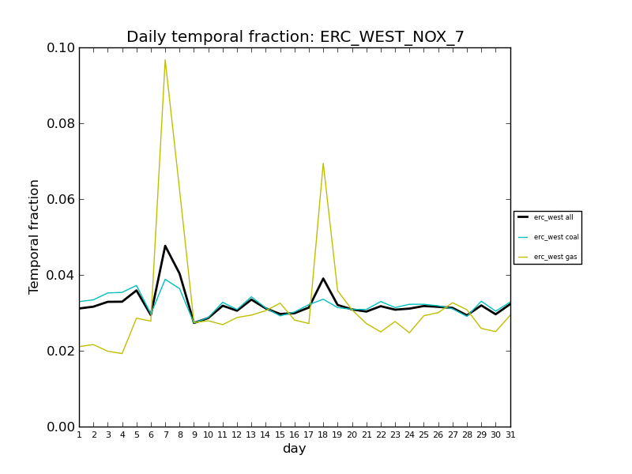
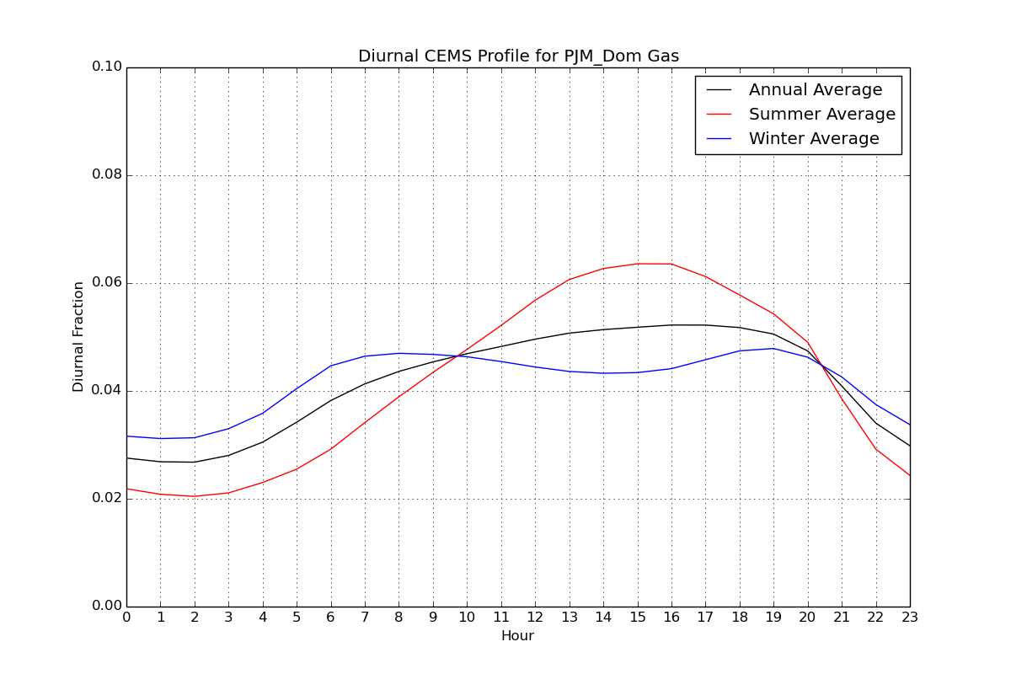
Temporal Allocation for EGUs without CEMS
EGUs without CEMS are temporally allocated based on averages of sources that have CEMS in each region by fuel and season
First to day of the year and then to hour of the day

Slide 11
Next Steps
Review EGU workgroup charge
https://docs.google.com/document/d/1SiR5UVt_8xIeNl5J42PDeQg0a6lBpVSmVbMDG0gOwX8/
(email us if you cannot access this)
Consider updates to temporal allocation
MARAMA applied alternative methods for temporal allocation of small EGUs that might be more broadly applicable
How should new sources and co-gens be temporally allocated?
Should we use broader regions for temporal allocation profiles?
How should sources that operate much differently in the future year than in the base year be temporally allocated?
Review the 2016 inventory once it becomes available
Meetings 4th Thursdays at 2, except February

